Slide 1
Continuous Integration

Slide 2
Why Continuous Integration?
“The key is to automate absolutely everything and run the process so often that integration errors are found quickly.”
Martin Fowler
--http://martinfowler.com/articles/originalContinuousIntegration.html

Slide 3
Continuous Integration
The Build: Backbone of Agile Development Process
Drives agile process
Leads to quick feedback
Based on automation
Adds rigor
Reduces waste
Creates a path to production

Slide 4
Continuous Integration
Benefits of continuous integration
Gives quick feedback on problems
Lowers cost of change
Gets the most out of automated testing
Facilitates whole-team approach
Tests builds and deployments using production-like processes
Reduces waste caused by manual integration
Provides a safety net so we can make changes with confidence

Slide 5
Continuous Integration
Core practices
Check in regularly
Create comprehensive automated test suite
Keep the build and test process short
Don’t check in on a broken build
Run all commit tests locally after updating, before committing
Never go home on a broken build (but be prepared when someone does)
Always be prepared to revert to previous revision
Don’t comment out failing tests/assertions
Visual build monitor

Slide 6
Continuous Integration
Supporting practices
Test-drive development
Collective code ownership
Coding standard
Pair programming
Emergent design
Fail the build for slow tests, warnings and code-style breaches
Rotating role of build cop
Red build/last check-in hat

Slide 7
Continuous Integration
A CI scenario starts with the developer committing source code to the repository.
Required features:
CI server
Version control system that is accessible from CI server
Automated build script that includes tests
Build monitor
Agreement of the team
Notes:
CI server = Process for integrating the source code changes

Slide 8
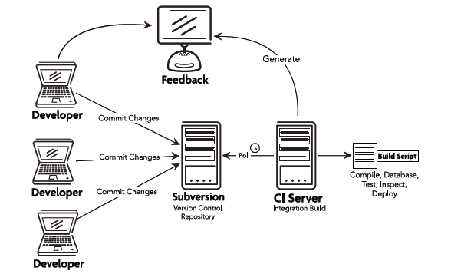
Continuous Integration

Slide 9
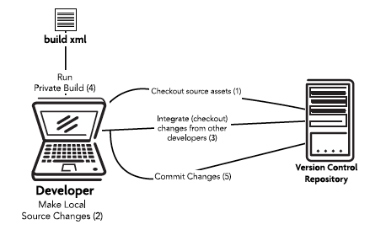
Workflow/Check-in steps

Slide 10
What is a successful build?
All the latest sources are checked out of the configuration management system
Every file is compiled from scratch
The resulting compiled code is put into binaries
The system is started and suite of tests is run against the system
Notes:
If all of these steps execute without error or human intervention and every test passes, then we have a successful build

Slide 11
Continuous Integration
Smells
Too many red builds
Long-running builds

Slide 12
Other considerations
Merging is a nightmare – why?
To branch or not to branch?
Definition of done
Code metrics
Notes:
Code metrics: test coverage, code complexity

Slide 13
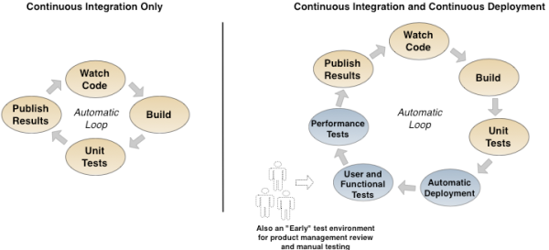
Continuous Integration and Deployment

Slide 14
Story #8
As a sales manager
I want to allow a free regular movie when the customer has 5 frequent renter points
So that I can encourage repeat customer

Slide 15
Continuous Delivery

Slide 16
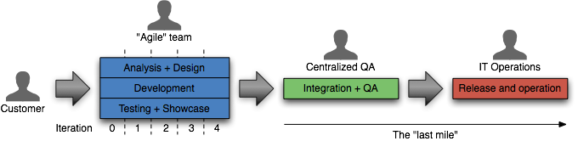
Continuous Delivery
Traditional approach to delivery
Notes:
How long would it take your organization to deploy a change that involves just one single line of code. – Mary and Tom Poppendieck
Do you do this on a repeatable, reliable basis?

Slide 17
Continuous Delivery
The ideal approach to delivery
Notes:
Through automation of the build, deployment, and testing process, and improved collaboration between developers, testers and operations, delivery teams can reduce cycle times and improve the quality of their software and the reliability of the release process.
Software always production-ready
Reliable deployments
Everyone can self-service deployments
Software is deployable if not deployed
Business drives releases: Releases tied to business needs, not operational constraints

Slide 18
Continuous Delivery
Principles
Create a repeatable process for releasing software
Automate almost everything
Keep everything in version control
If it hurts, do it more often, and bring the pain forward
Build quality in (Deming)
Done means released
Everybody is responsible for delivery
Continuous improvement

Slide 19
Deployment Pipeline
Notes:
deployment pipeline: a pattern for modeling the delivery process, ensuring everyone in delivery can self-service deployments, and providing fast feedback on the production readiness of their software upon every change to its source or configuration

Slide 20
Deployment Pipeline

Slide 21
Continuous Delivery
Stages and environments
Commit stage
Acceptance stage
Manual stages
Deployment stages

Slide 22
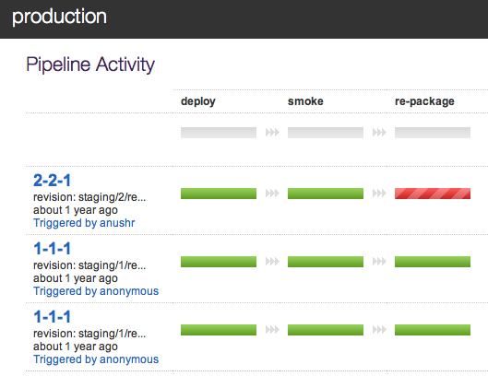
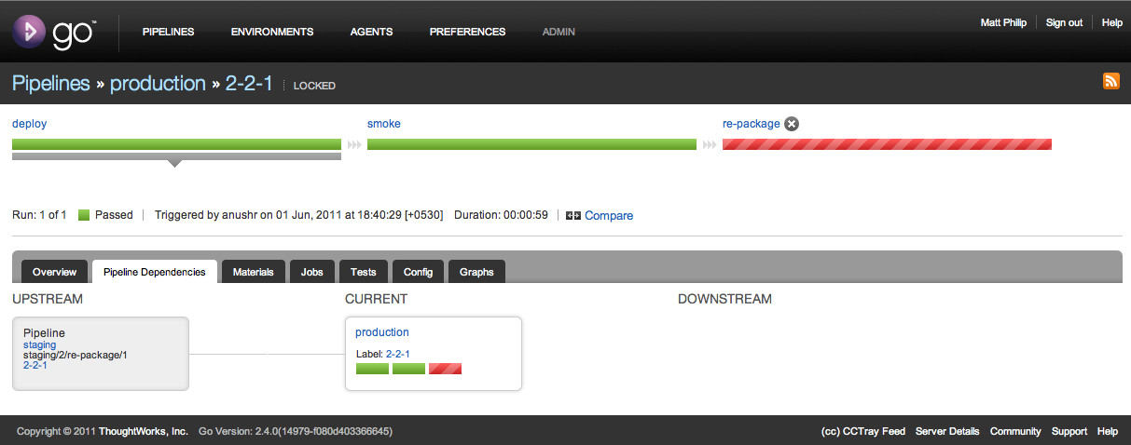
Continuous Delivery with Go

Slide 23
Continuous Delivery
Practices
Build your binaries only once
Deploy the same way to every environment
Smoke test your deployments
Keep your environments similar
If anything fails, stop the line

Slide 24
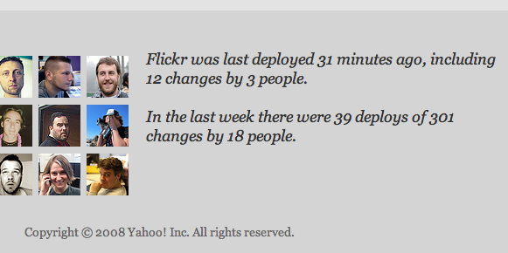
Continuous Delivery
Continuous Deployment
Deploying every good build to production
Automation must exist end-to-end
Reduces the risk of each individual deployment

